Slide 1
PERSATUAN BUDDHIS MELAKA
(MALACCA BUDDHIST ASSOCIATION)
(SECK KIA EENH)
1920 - 2016

Slide 2
MEMBERSHIP!
MORE THAN 3000!
WHO ARE THE REGULARS?
WHERE ARE THE MAJORITY?

Slide 3
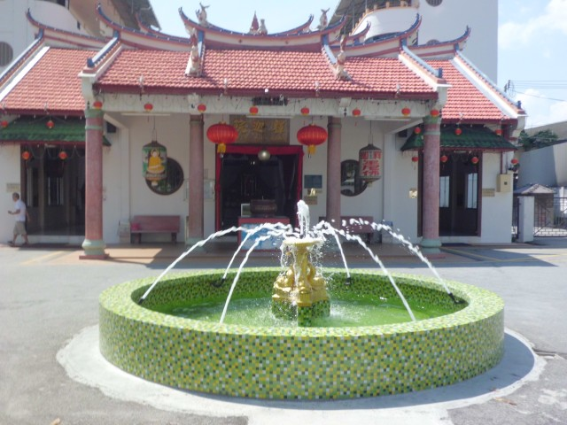

Slide 4
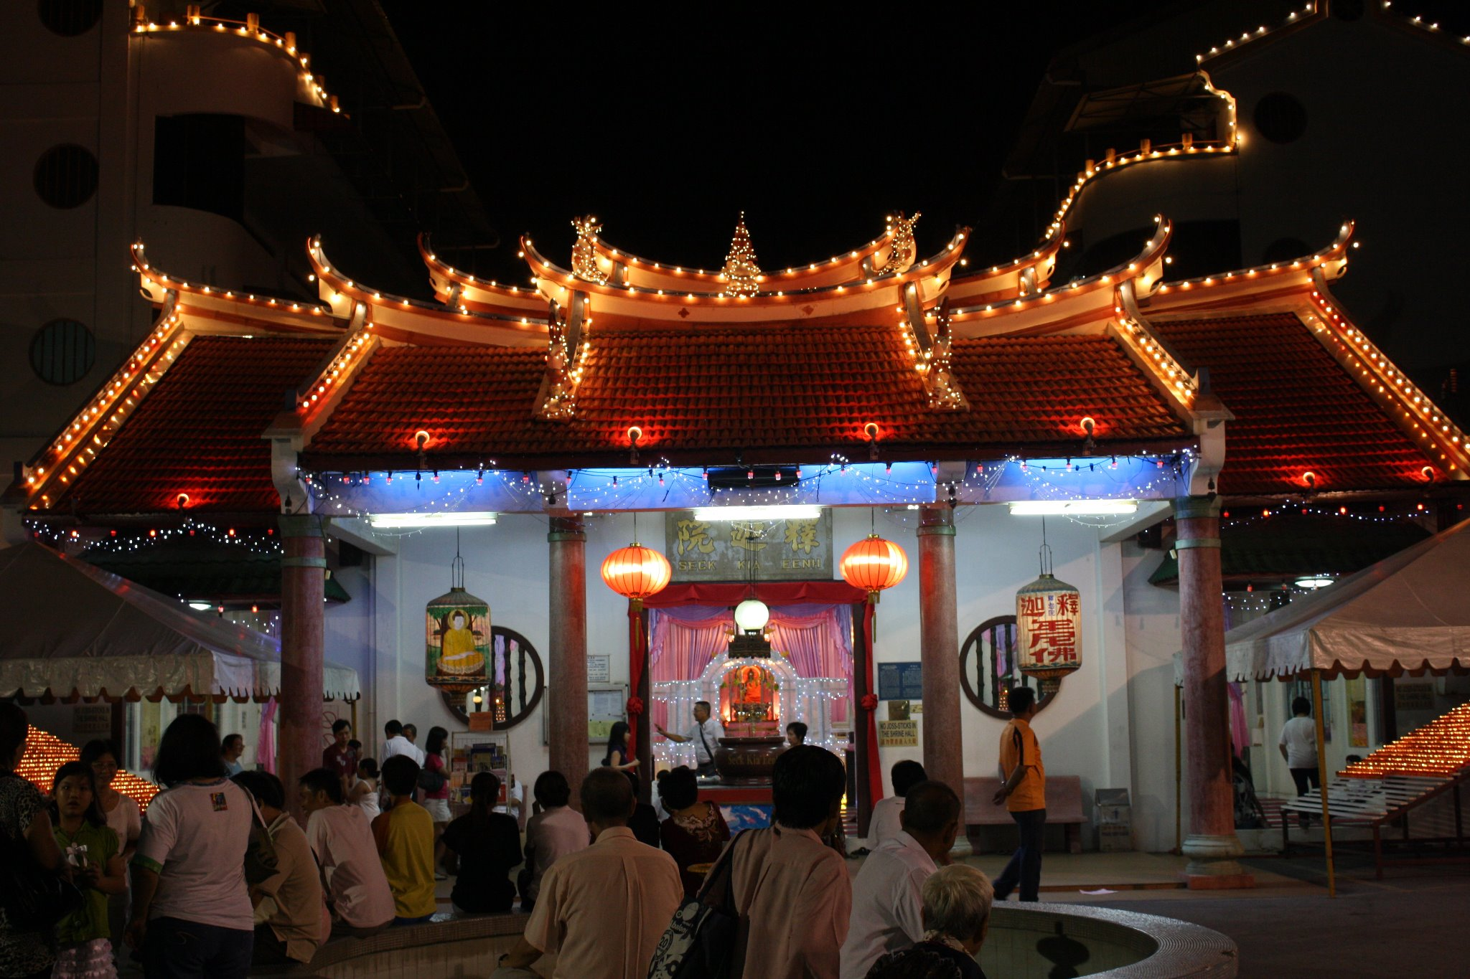

Slide 5
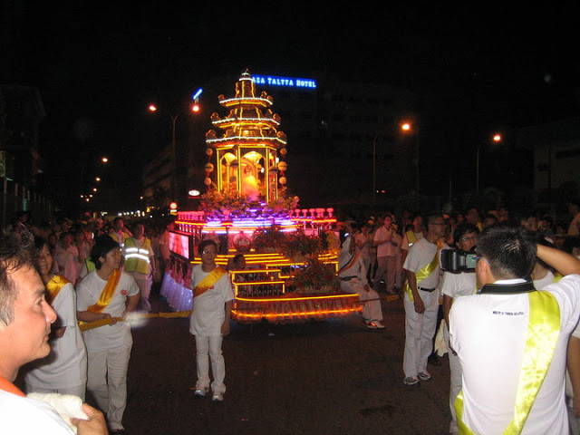

Slide 7
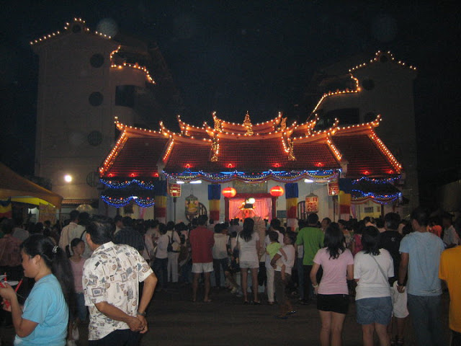

Slide 8
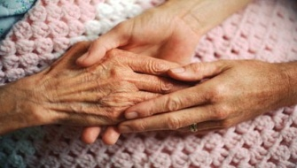
SKE SUVARNAMITRA
OR
SKE SUVARNAMITRA
SKE SUVARNAMITRA CIRCLE
OR
OR
SKE SUVARNAMITRA
SKE
SUVARNAMITRA

Slide 9
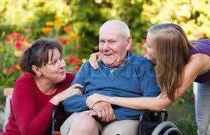
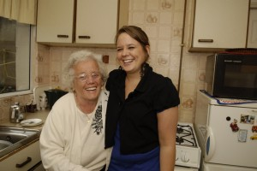
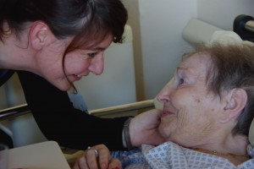
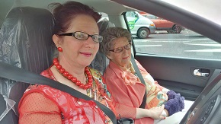
Loneliness
In the Kitchen
SKE SUVARNAMITRA
The sick and in hospital
Transport Support

Slide 10
THE CATALYST
comprises the core members as coordinators
two members from the catalyst to coordinate one cluster
each cluster can have certain number of volunteers
if cluster is too big, can form sub-clusters
CLUSTERS
for a start, nine clusters are indentified
identify at least five elders in the each cluster
recruit volunteers to help out

Slide 11
AYER KEROH
BUKIT KATIL
BUKIT BERUANG
DUYONG
BATU BERENDAM
CATALYST
UJONG PASIR
CHENG
KLEBANG
BANDAR HILIR

Slide 12
THE CATALYST
A whatsapp group has been created. So far, the group remains strong but certainly more volunteers are required.
These are some of the people who are in the group:
Bro. Tay Giap Beng 10. Sis. Koot Siew Man
Bro. Alfred 11. Sis. Sophia
Bro. Eddie Teo 12. Sis. Metta Ham
Bro. James Lee 13. Sis. Lilli Lee
Bro. Lim Boon Chee 14. Sis. Jasmine Kerk
Bro. Loh Chun Chong 15. Sis. Annie Khoo
Bro. Micheal Seow 16. Sis. Ang Siew Kien
Bro. Mike Lee 17. Sis. Kate Neo
Bro. Tan Ching Hua
We need MORE volunteers!!!
If each cluster has FIVE volunteers, we will have already at least 45 volunteers (nine clusters). If each cluster can identify FIVE elders, we will have 45 happy elders!

Slide 13
For a start
Help SKE to mobilize the members by looking into the data base those staying in the respective cluster.
Identify and recruit volunteers.
Identify suvarnamitras in the cluster.
Draw up plan and look into logistic to keep the cluster dynamic and sustainable
Activities
Monthly home visits, cheering up and fellowship
Provide transport to attend temple activities, especially on Sundays
Conduct religious activities like simple and short walking and sitting meditation
Provide transport to doctors and the grocers
Regular contact through whatapps, internet and the handphone
Visit the sick at home or the hospital

Slide 14
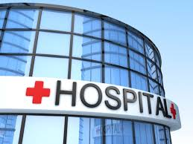
Main Hospitals in Melaka
AYER KEROH
BUKIT KATIL
Pantai Hospital, Ayer Keroh
BUKIT BERUANG
General Hospital, Pringgit
BATU BERENDAM
CHENG
Putra Hospital, Pengkalan Rama
UJONG PASIR
DUYONG
Hospital Makhota, Melaka Raya
BANDAR HILIR
Oriental Hospital, Klebang
KLEBANG

Slide 15
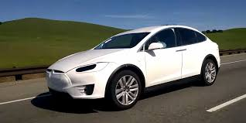
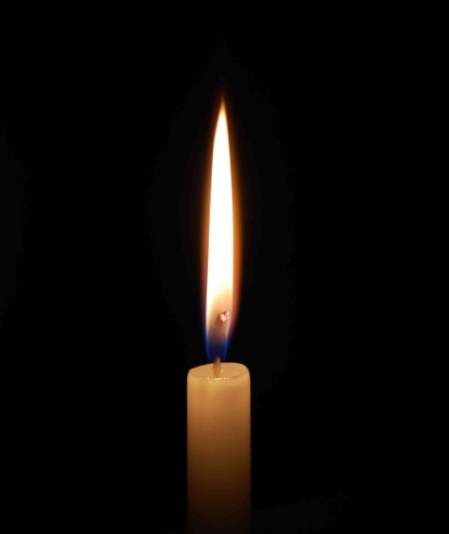
I wonder Auntie so and so wants a lift to the temple!

